Slide 1



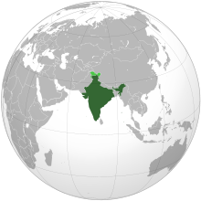
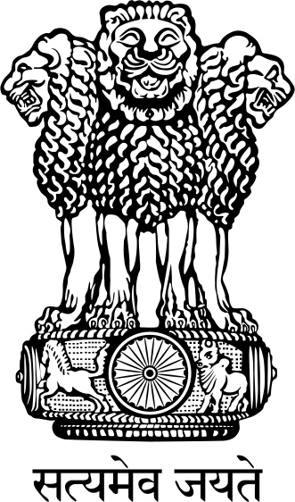

INDIAN CONSTITUTION

Slide 2
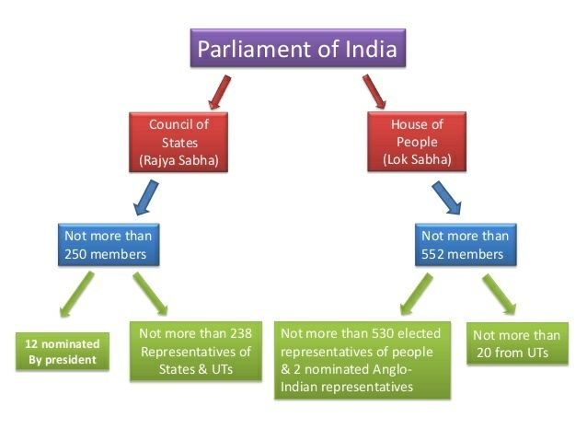

Slide 3
Rajya Sabha and Lok sabha
The parliament of India consists of the president, Lok sabha, and Rajya sabha, which act as the highest legislative body of the Assembly.
The Rajya Sabha and Lok sabha are the two integral houses of the parliament of India.
There are 250 Rajya sabha members while Lok sabha has 543 members.
Lok Sabha is the lower house while Rajya Sabha is the upper house of the parliament
Lok Sabha and Rajya sabha are important in the country for their better and smooth running.

Slide 4
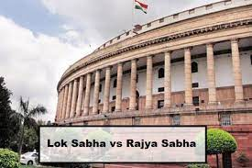
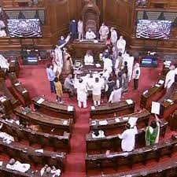
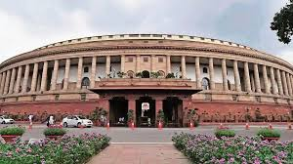

Slide 5
Lok sabha
Also known as the ‘House of People’, Lok sabha has 543 members directly elected by the country’s citizens responsible for the president’s confidence in choosing the country’s prime minister.
Lok Sabha members have a tenure of 5 years, after which the Assembly and the members dissolve to have a fresh election.
The members who appoint the prime minister of the country, Lok sabha members, have more powers than the Rajya Sabha members.
One of the most powerful is that they can pass a no-confidence motion against the ruling party and can dissolve the existing Assembly

Slide 6
Functions of Lok sabha
Legislature: Lok sabha has to pass bills and laws and reforms for state and union territories strengthening the national and interstate interests of the country
Finance matters of the country: Lok sabha members are the enacting body of the financial bills and reforms of the country, which are to be successfully implemented in the country
Consent to the Rajya sabha to make every national or state interest decision
The country’s parliament can only do high court or supreme court judge removal

Slide 7
Rajya sabha
The upper house of the parliament, the Rajya Sabha, is responsible for the affairs of the state and the protection of state rights in response to the centre and union legislature.
Implementing the passed bill in the state has to be passed in the Rajya Sabha. Rajya Sabha is a permanent house whose one-third of members are elected every two years.
It consists of 250 Rajya Sabha members, with the vice-president as the head of the Sabha. Rajya Sabha is limited to some powers compared to Lok sabha; still, it can protect the various rights of state and union territories.

Slide 8
Functions of Rajya Sabha
She represents various state and union territories of the country
A bill can be amended in the country as the law only if it has been passed in both Rajya Sabha and Lok sabha
Authority to alter and review the bills sent and passed by the Lok sabha. Only after acceptance from Lok sabha, a bill will become a law
The president of the country selects twelve members of the Rajya sabha

Slide 9
Difference between Lok Sabha and Rajya sabha
Rajya sabha | Lok Sabha
While Rajya sabha is about protecting the several rights of the state | Lok sabha is about passing the bills and laws for the smooth running of the country
the vice president is the representative of the Rajya sabha | The speaker is the representative of the Lok sabha
Rajya Sabha is a permanent body, with one-third of the members retiring after two years | While the Lok sabha members have five years
While Rajya Sabha can pass no bills | Lok sabha can pass abrogate the existing one
Lok Sabha is much more powerful than Rajya sabha in every aspect
The Assembly of the state elects the Rajya sabha members, | while The country’s people directly elect Lok sabha members

Slide 10
-THANK YOU-

